Slide 1


PRESENTED BY –SABARISH M S
CSE 3RD YEAR

Slide 2
^{UNIT -3}
PROBLEM SOLVING BY NON-CLASSICAL AND ADVANCED SEARCH

Slide 3
NON-CLASSICAL SEARCH
LOCAL SEARCH ALGORITHM
OPTIMIZATION PROBLEMS
Hill-Climbing Search Algorithm
Simulated Annealing
Genetic Algorithms
Tabu Search

Slide 4
LOCAL SEARCH ALGORITHMS
Working of Local Search Algorithms
Step 1: Pick a starting point: Start with a possible solution which is often random but sometimes based on rule.
Step 2: Find the neighbors:
Neighbors are similar solutions we can get by making small, simple changes to the current one.
For example, in a puzzle, swapping two pieces creates a neighbor.
Step 3: Compare: Look around at all neighbors to see if any are better.
Step 4: Move: If a better neighbor exists, move to it, making it our new “current” solution.
Step 5: Repeat: Keep searching from the new point, following the same steps.
Step 6: Stop: When none of the neighbors are better or after enough tries.

Slide 5
1.HILL CLIMBING SEARCH ALGORITHM
Hill Climbing is a local search algorithm that continuously moves towards the neighbor state with the highest value (or lowest cost) until no better neighbors exist. It’s simple and fast but can get stuck in local maxima or plateaus, making it incomplete and not always optimal.

Slide 6
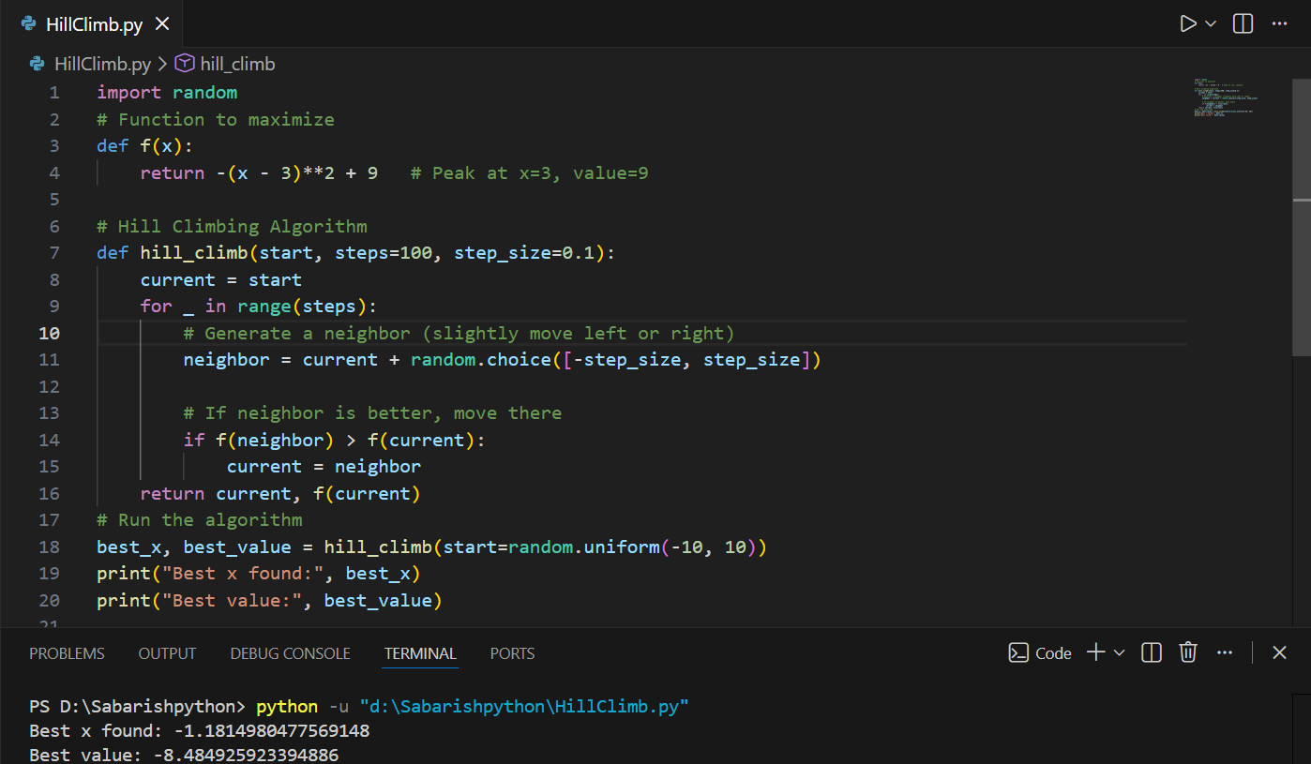
EXAMPLE

Slide 7
2.SIMULATED ANNEALING
Simulated Annealing is inspired by the annealing process in metallurgy, where materials are heated and then gradually cooled to remove defects. It allows for occasional moves to worse solutions to escape local optima, with the probability of such moves decreasing over time

Slide 8

EXAMPLE

Slide 9
3.GENETIC ALGORITHMS
Genetic Algorithms (GAs) are inspired by the process of natural selection and evolution. They work with a population of solutions and evolve them over time using genetic operators like selection, crossover and mutation.

Slide 10
PROCESS OF GENETIC ALGORITHMS
Process:
Initialize: Start with a population of random solutions.
Evaluate: Assess the fitness of each solution.
Select: Choose the best solutions for reproduction based on their fitness.
Crossover: Combine pairs of solutions to produce new offspring.
Mutate: Apply random changes to offspring to maintain diversity.
Replace: Form a new population by selecting which solutions to keep.

Slide 11

EXAMPLE

Slide 12


Slide 13
TABU SEARCH
Tabu Search is a local search algorithm that uses memory structures to avoid revisiting recently explored solutions. By keeping a “tabu list” of forbidden moves, it helps escape local optima and explore new areas of the search space.

Slide 14
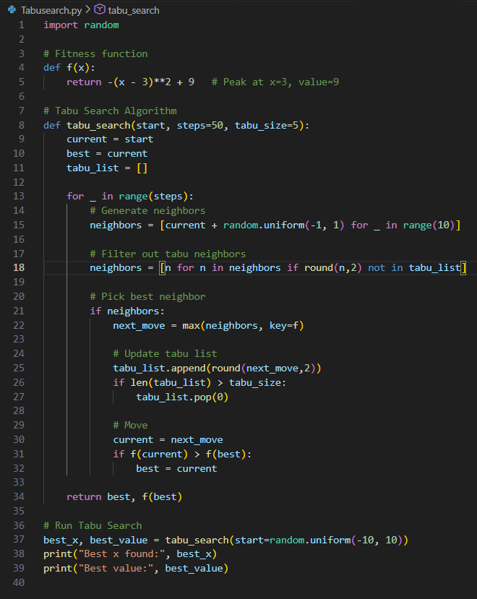
EXAMPLE

Slide 15


Slide 16
OPTIMIZATION PROBLEMS IN ARTIFICIAL INTELLIGENCE
🔑 Core Idea
Optimization in AI is about finding the best solution among many possibilities. It underpins machine learning, model training, hyperparameter tuning, feature selection, and decision-making in autonomous systems.

Slide 17
📌 Importance
Enables AI systems to learn efficiently and improve performance.
Critical for handling large datasets and complex decision-making.
Helps models generalize to unseen data.
Essential in solving real-world problems like scheduling, routing, and portfolio management.

Slide 18
📈 Applications 1. Training neural networks. 2. Hyperparameter tuning. 3.Feature selection. 4.Scheduling, resource allocation, and routing. 5.Decision-making in robotics, finance, and autonomous systems.

Slide 19
LOCAL SEARCH IN CONTINOUS SPACE
A local Search is first Conducted in the Continuous Space until a local Optimum is reached.
It then Switches to a discrete space that represents a Discretization of the Continuous model to find an improved solution from there.

Slide 20
The process continues switching between the two problem formulations until no further improvement can be found in either.
To perform a local search in continuous state space we need techniques from calculus.
The main technique to find a minimum is called a gradient descent.
Gradient descent measures how much the output of a function changes, if you change the inputs a little bit.

Slide 21

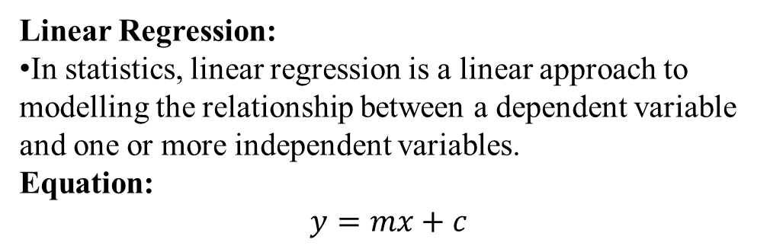


LINEAR REGRESSION
Linear Regression:
In statistics, linear regression is a linear approach to modelling the relationship between a dependent variable and one or more independent variables.
Equation:
$$y=mx+c$$
Дy
Дx

Slide 22
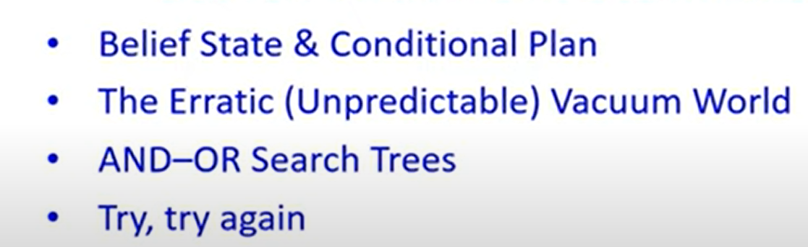
SEARCHING WITH NON DETERMINISTIC ACTIONS

Slide 23
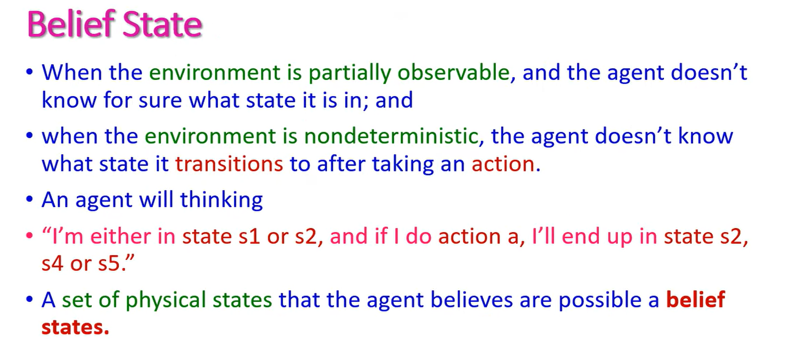

Slide 24
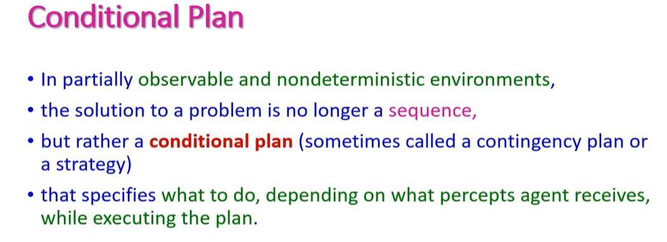

Slide 25
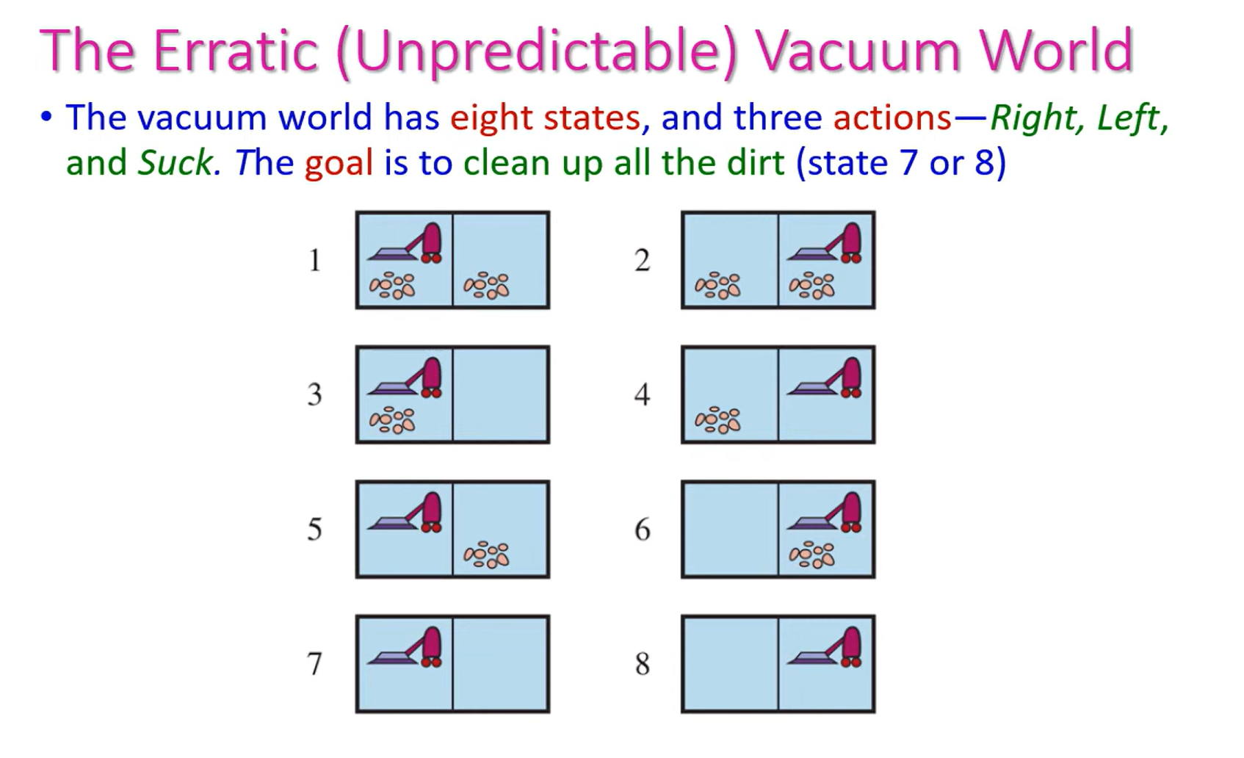

Slide 26
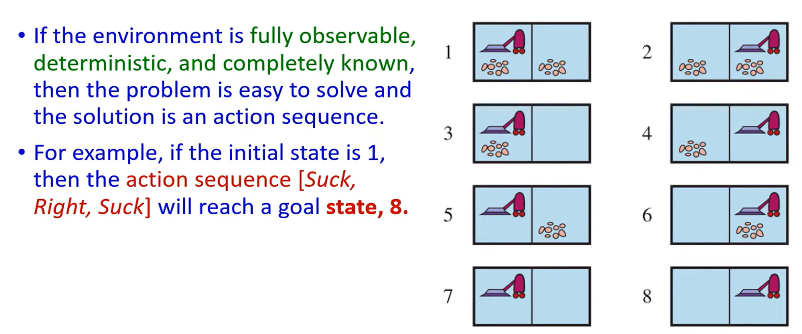

Slide 27
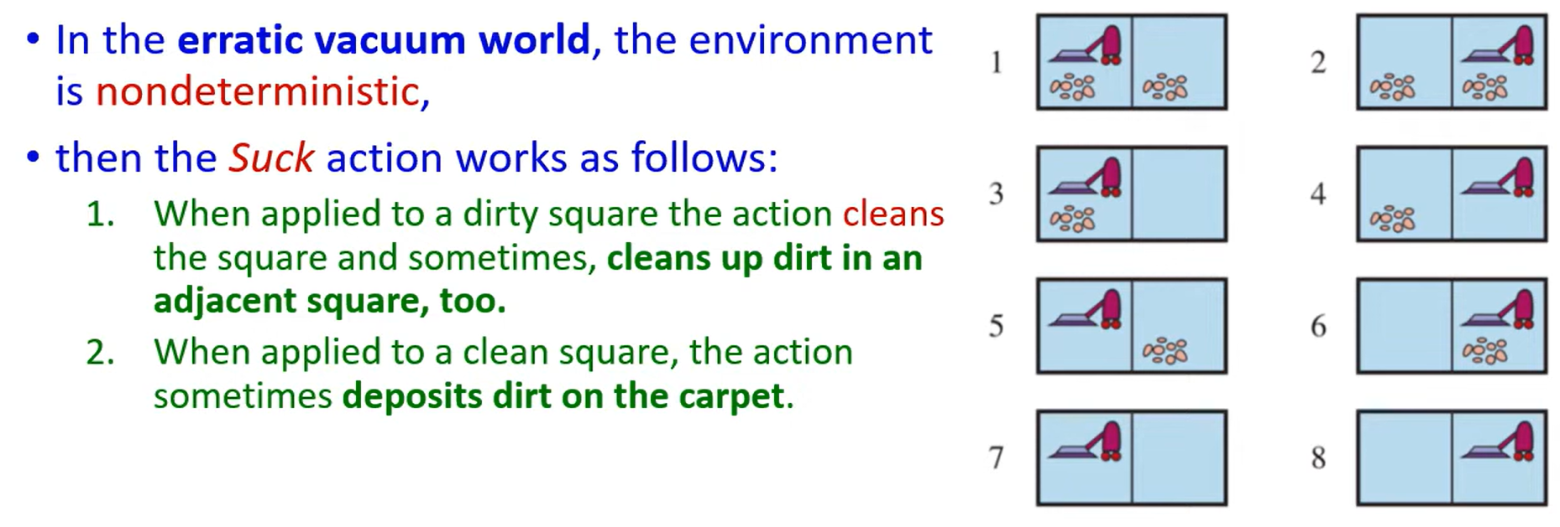

Slide 28
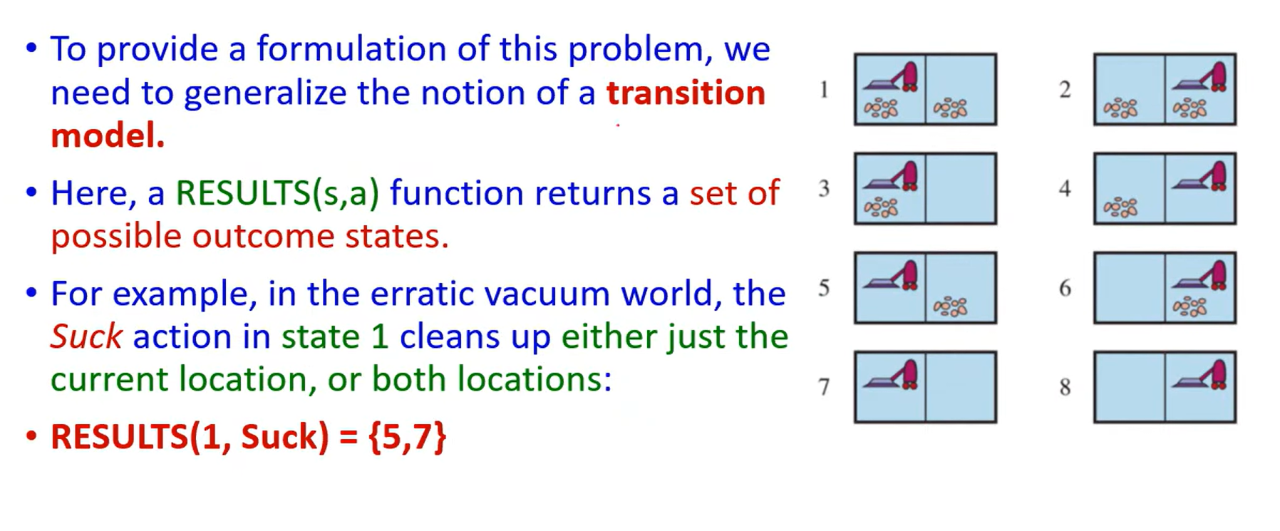

Slide 29
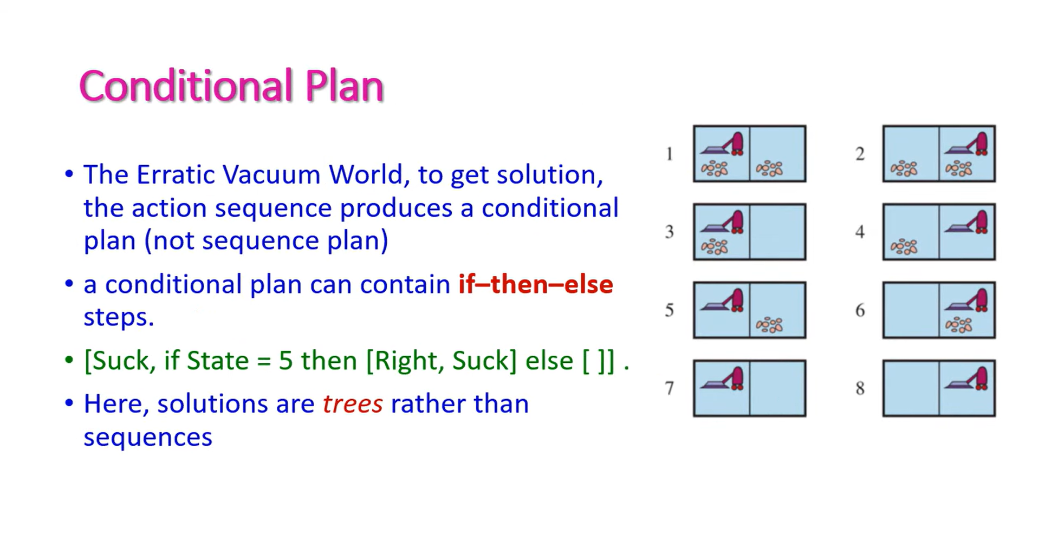

Slide 30
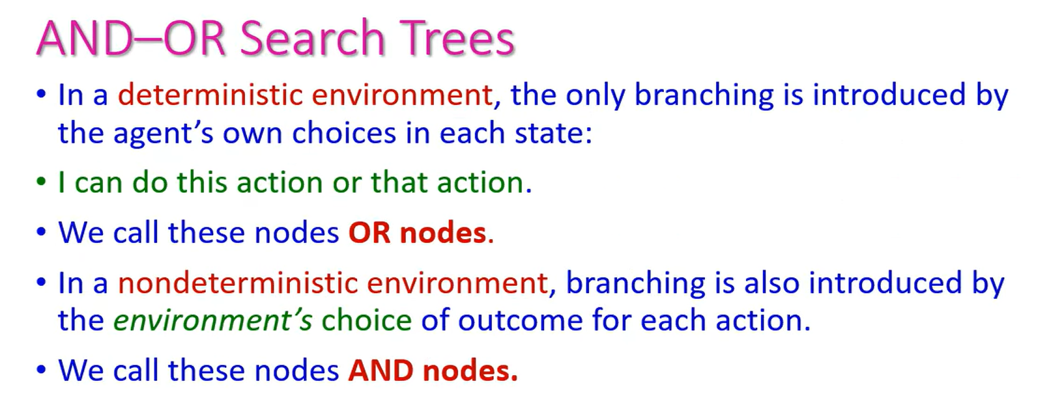

Slide 31
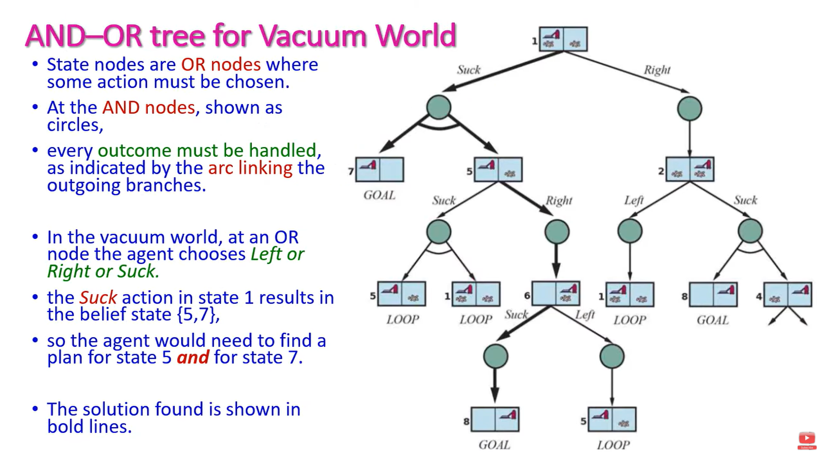

Slide 32
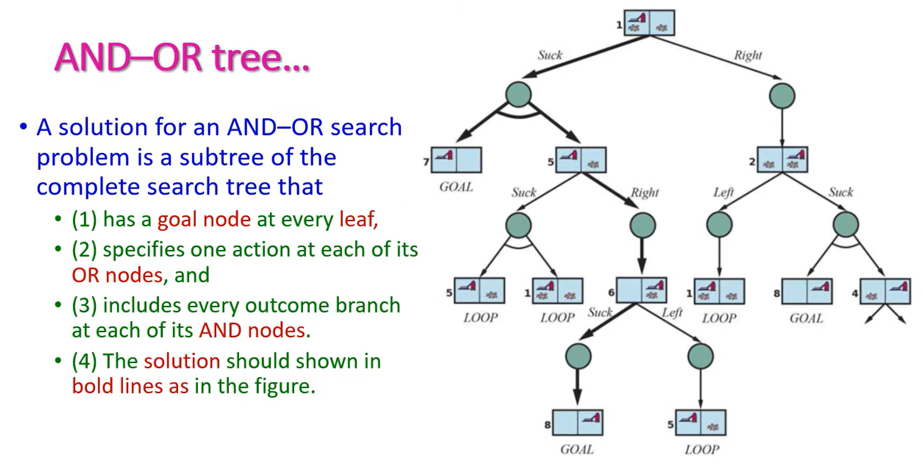

Slide 33
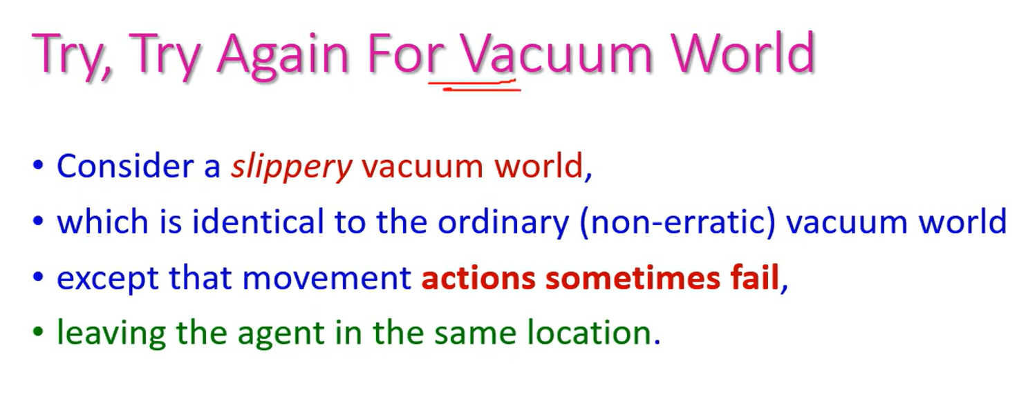

Slide 34
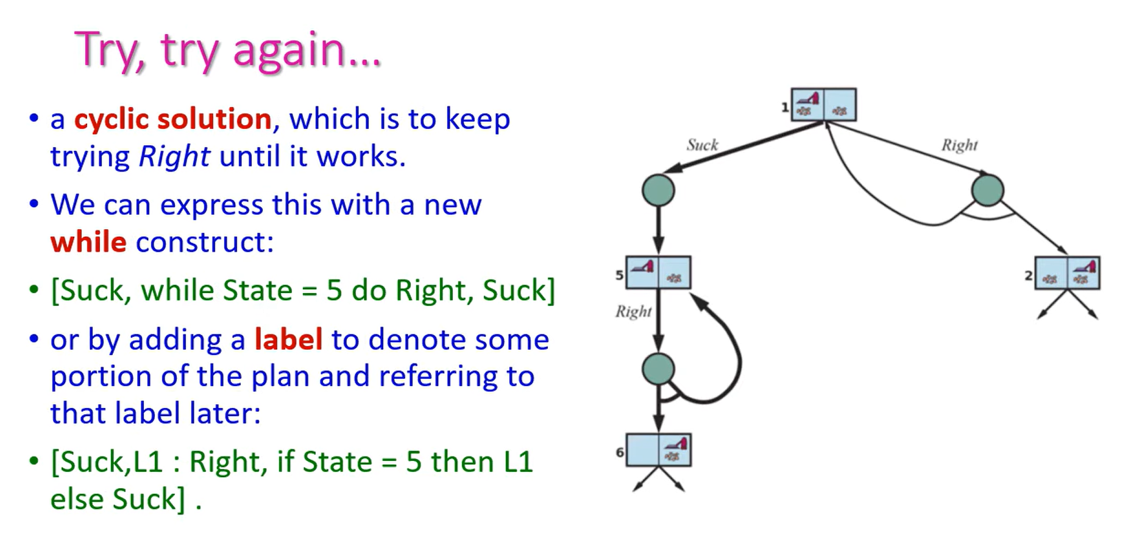

Slide 35
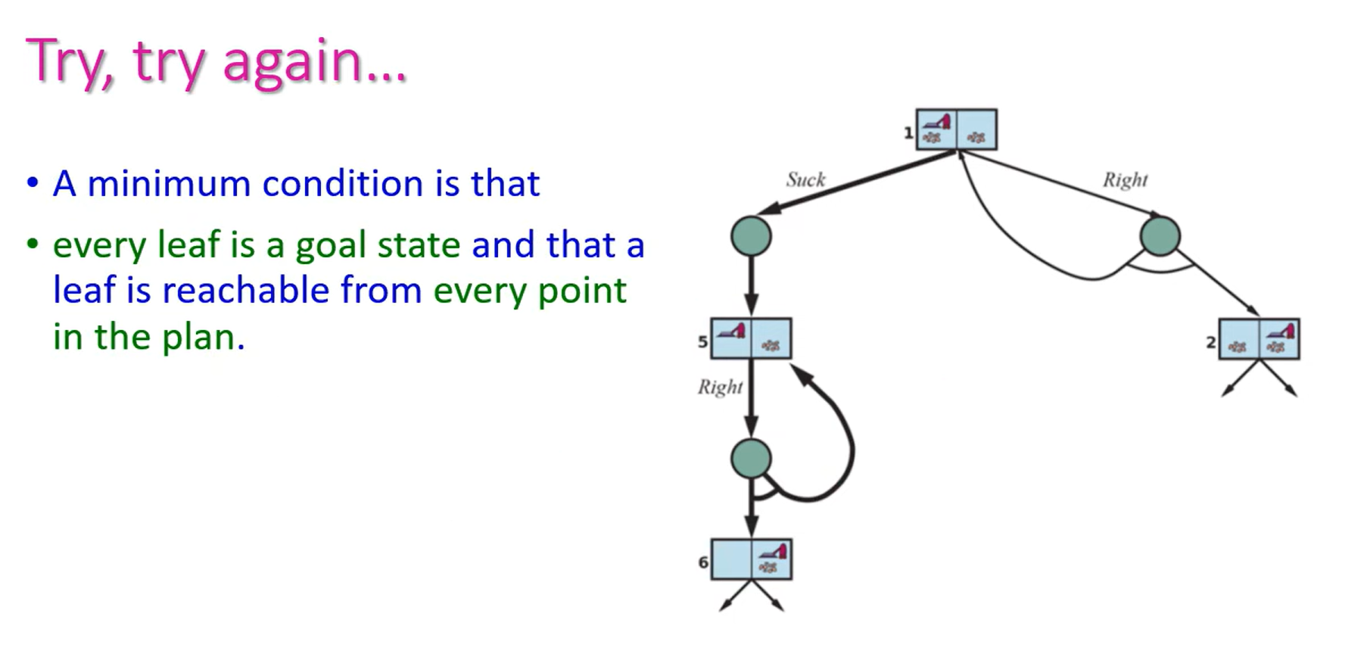

Slide 36




A VERY BIG THANK YOU FOR YOU’RE SUPPORT!!!
VIEW DESCRIPTION FOR RESOURCES!!!!

